Slide 1


PLEDGE TO PROGRESS Sustainability Hackathon
Sponsored By
Your Team Name : Woods
Your team bio : Sustainability Champion
Date : 6-05-2023

Slide 2

Why Sustainability ?
Humans use natural resources to run their day to day life, their ecomonies yet have done irreverisible change to our planet. With increaing impact and discussion around climate change more and more individuals and companies are trying to become carbon neutral… which is good !
But we are still not doing enough for making world livable place.United nation has classified 17 areas of work and tackling climate issue is one of them and the most pressing issue. But it does not mean we ignore others.... For me a sustainable solution is the one which can make planet greener and more livable at the same time.

Slide 3
Microsoft have taken first step…
By Implementing Microsoft Sustainability Calculator.
End customers can now understand their carbon usage while using Azure, get suggestions on how they can reduce their carbon footprint by tweaking their network and service usage. But they would still have carbon footprint for their IT infrastructure whereas they aim to be carbon neutral/free
Earning carbon credits and carbon sequestration is the only way they can achieve their goal. So plant trees !
Plant trees with your cloud provider by choosing online how many plants you want to invest in and in which part of world which can be incorporated Environmental Credit service in Azure and can pay for their plantation requests along with other expenses in Azure.
Moretrees.com partners with many tree plantation companies in background and help grow and maintain trees. They do provide tracking mechanism to track progress of trees planted … so its not just tree plantation drive, they maintain trees as well. This provide jobs to many poor and needy people in area and improve their living conditions.

Slide 4
How APIs can help plant trees ?
Moretrees.eco provides different ways to connect with them and place order for planting trees. They also provide a fancy dashboard to let customer know the status of plants, carbon credit they have earned and so on.
Moretrees.eco can be connect via :
1. APIs
2. Zapier (workflow automation)
3. IFTTT
Details can be found at : Tree planting & tree gifting API user guide | (more:trees) (moretrees.eco)
They also provide a dashboard to track status of the order, plants you have planted so far, total credits earn, etc. Customer can be billed for their plantation request. Depending on the data returned by moretrees APIs , MS sustainability data model can be enriched and end customers can be provided information on dashboard.
By planting trees you help sequester CO2 emissions while providing co-benefits such as water filtration, shelter, food sources, poverty alleviation and biodiversity.

Slide 5
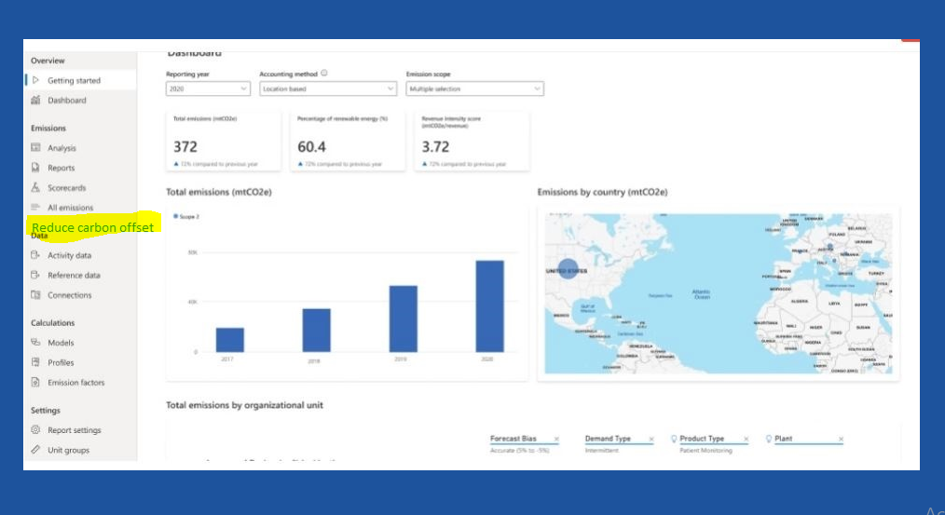
Wireframes

Slide 6
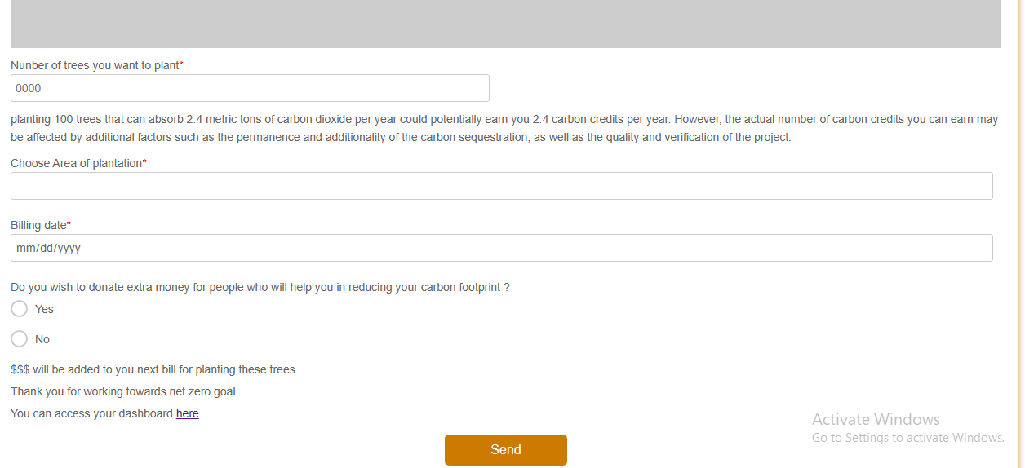
Wireframes

Slide 7
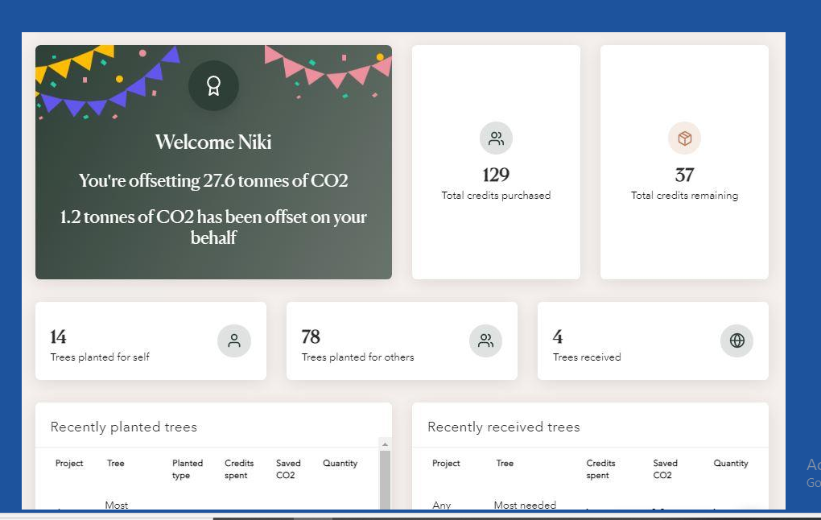
Wireframes

Slide 8
Benefits are multifold…
Obvious Climate benefits of Planting trees :
- Increasing O2 levels
- Decreasing Co2 levels
- keep planet cooler
-- reduce soil erosion
-- restore wildlife / spices
-- soothes humans
Additionally Sustainability benefits
-- people planting trees will have a job
-- may be better education for their children
-- having a job may reduce crime in area
-- which in turn may improve living conditions for minors/females in area
-- Customers planting trees and tracking reports will have opportunity to contribute in broader sustainability agenda
-- Customer can imbibe carbon tracking culture in their companies

Slide 9
For Demo or queries write moretrees.eco at :
info@moretrees.eco
OR
Call on (UK +44) 08001510751

